Slide 1
Machine Learning: Reward
Unity ML lesson : Reward
Notes:
The first 4 slides look great to introduce how computers can learn like humans do.
The rest explore the concepts in a way that middle/high school might be able to understand, but we’ll need to lower the entry for elementary school.
A technique that works great in public speaking (like teaching) consists on storytelling. Introducing or teaching concepts through a narrative that hooks the readers/students. It is about taking your readers/students through a journey, a story usually following:
Context: introduces the protagonists
Conflict: introduces an obstacle for the protagonist
Climax: turning point, protagonists faces the problem and starts solving it
Conclusion: the wrap-up of the learnings, of the story
The kids, before this lesson should’ve already gone through introduction to programming and have done minor coding to control a robot. This is perfect as the robot gives us an anchor point to grab the kids attention. We can use the story of cleaning the dwamish river with robots, obstacles that it could find and it’s goal in “life” kick the garbage out of the river.
Context: Protagonist, robot
Conflict: River pollution and how hard is it to manually clean it, dangers, what about robots cleaning it… but how?
Climax: Just like we humans learn how to do xyz, we can tech computers in a similar way with reinforcement learning!
Conclusion: Using this technique our robot learns how to clean the river! No need to put people in danger.
I would suggest to go slide by slide, think about the story you want to tell (the above is an example but you could use it) and try to stitch the slides in a way that follow the narrative. We might need to increase the number of slides but that’s OK we can at the end decide how do we trim them down.
-----------------
With the above in mind, even before we introduce the concept of reinforcement learning we need several slides introducing the story of the robot. When you get to the climax of the story, presenting those slides would be perfect to make the analogy that the robot will learn like a dog, with a treat or a sad face as positive and negative rewards.
-----------------
We could also add an introduction slide(s) as you work on the narrative, to explain what artificial intelligence is in simple terms.
We could even play with the idea that scientist, very smart people working on the area has not been able to come up with the same definition
Nevertheless many of them agree that just like human intelligence, artificial intelligence is about how to make machine behave or “think” like humans e.g. to see (camera), to hear (microphone) and react to stimulus in the environment.
-----------------
Notes:
http://learn.makeblock.com/en/mbot/

Slide 2
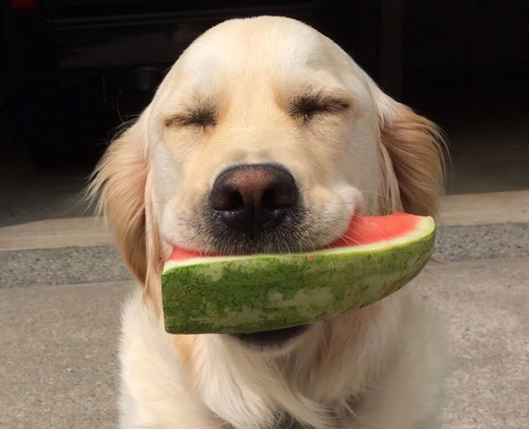
Reinforcement learning:
It’s like training a dog!
By using positive and negative rewards, we teach our AI how to respond to different situations, just like teaching a dog a new trick!
Notes:
I really love the way you’re introducing reinforcement learning ☺

Slide 3


1. Reinforcement learning
What is reinforcement learning? How we train our AI to make better decisions
Positive and negative reinforcement How we tell our AI how it’s doing
Connection to observations How the AI learns to improve it’s behavior over time with reward
Notes:
Referring to the narrative idea, can we present or show this three concepts with pictures, or a set of slides that: robot senses the environment, does an action like moving, gets a rewards (if achieved its goal, like removing garbage) and everything repeats. Maybe this slide can go at the end, with extra pictures showing the mbot robot on a river, to do a recap of what they learned.

Slide 4
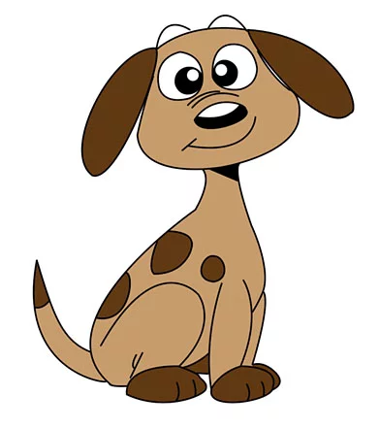

We can use both positive and negative reward values to shape the behavior of our AI, the size of the reward lets the AI know how well or how poorly it’s doing:
Tip
We can use smaller and larger reward values for different behavior
Think about using small rewards for small tasks, and big rewards for important things like winning or losing the game
Good Boy! -> AddReward(1);
Bad Dog! -> AddReward(-1);
Notes:
1. Can we explore the differences between rewards? At this point we’ve already introduced the kids on the idea of positive and negative rewards, but we could give examples of what’s positive for a dog, like a treat, and negative like a sad face.
2. We could put notes for the teacher in here, e.g. they can ask the students what do they think is a positive reward for a dog, when would that happen? What about a negative reward?
3. We can change AI for robot, that way they can make a better connection with the narrative and what they’ve done.
4. When introducing difference on rewards we can give examples that relate either to the dog, or the kids. E.g. for a dog a small reward could be a “good boy/girl”, a really good reward is like taking him/her to the park and a treat at the end.
5. We should change the “add reward” functions to abstract it a bit more, e.g. GiveTreat() or GiveSmallReward. That way we avoid using numbers and explaining that.

Slide 5
We can use code to test if our AI is getting close or further from the goal of the game, then we can use reward to let the AI know
Example:
If (we are closer to the target)
{
AddReward(0.1);
}
If (we are farther from the target)
{
AddReward(-0.1);
}
If (We are at the target)
{
AddReward(1); //We did it!
}
Tip
Here we use if statements to check on the AI’s progress
We use positive and negative reinforcement to encourage it to reach a target
Notes:
This is a good moment to give an activity to explain why or how to use an if statement.
We should also show that this is a loop, maybe with a picture of the robot and a set of slides that show an “animation”.
This will help understand that at every time the robot moves, it has to make a decision.
This slide might be better placed after the exercise (slide8) as a tip on what to do in the code.

Slide 6
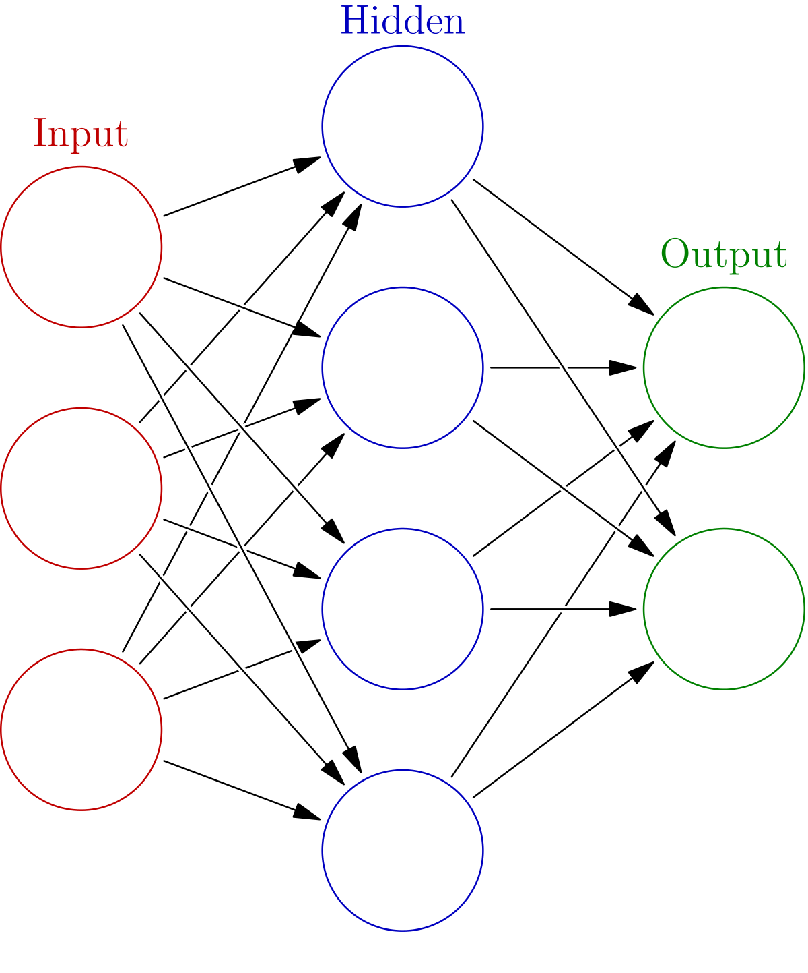
Connection to observations:
We use reward to change how the AI responds to different input.
Over time, the AI uses reward values to change the strength of the connections (shown here was white lines) between nodes.
By using positive and negative reward we can tell the AI to make the connections stronger of weaker, changing our output. This makes our AI’s behavior better!
Notes:
We want to fix the color of the NN
Can we put this image inside of a brain, on top of the robot or something like that? This is a good moment to explain that the computer will have a brain, and the “inputs” are the sensor of the robot. The output, the actions it can do.
The teacher will need some notes to explain at high level: human brain, neurons, and how we use something similar inside of the robot called artificial neural networks.

Slide 7
Applying what we’ve learned:
When our AI does something good:
Give it positive reward: AddReward(0.1);
If it wins the game, give it a big reward: AddReward(1);
When our AI does something bad:
Give it a negative reward: AddReward(-0.1);
If it loses the game, give it a big negative reward: AddReward(-1);
Notes:
We should move this one after the exercise (slide 8) but before the slide with the if statements.
This one feels like the next tip after introducing the challenge/exercise
Slide 5 gives even more clues (almost the code they have to write)
At the end, it feels like Slide8 -> Slide7 -> slide5 gives a better progression

Slide 8
Exercise!
If our AI is getting farther away from the goal what type of reward should we give it? Big or small? Positive or negative?
What if our AI reached our goal and won the game?

Slide 9
Exercise!
If our AI is getting farther away from the goal what type of reward should we give it? Big or small? Positive or negative?
Small Negative reward:
We don’t want the AI to do that, so we give it a small negative reward!
What if our AI reached our goal and won the game?
Big positive reward
We really want our AI to do that, so we give it a big positive reward!

